Slide 1
Chapter 5 Files and Exceptions
Jing Cheng
QQ: 42546062

Slide 2
Outline
What is a File?
Accessing Files: Reading Text Files
Accessing Files: Writing Text Files
Reading and Writing Text Files in a Program
File Creation and Overwriting
First Cut, Handling Errors
Example: Counting Poker Hands

Slide 3
5.1 What is a File?

Slide 4
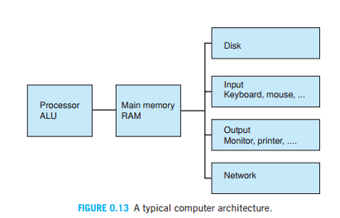
Temporary storage
Permanent storage ——Disk——File

Slide 5
Two Types of File
text files，human-readable
binary files， not human-readable

Slide 6
5.2 Accessing Files: Reading/Writing Text Files

Slide 7
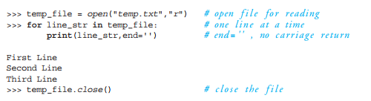
Three key Steps：
Open a file
Reading or Writing records from/to a file（loop）
Close a file

Slide 8
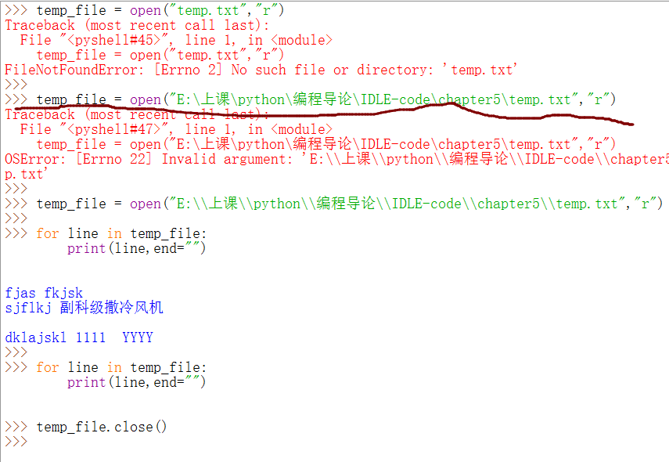

Slide 9
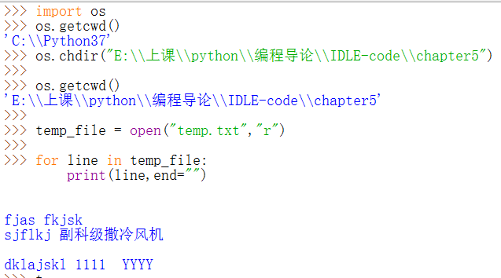

Slide 10
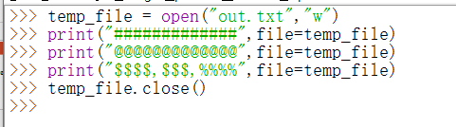
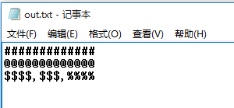

Slide 11
What’s Really Happening?
Disk file1.txt
……..
Input(Reading)
CPU
RAM
Output(Writing)
Open a file ➔ 将文件读入内存 （放在一个buffer里）➔ 在program和file之间建立connection/ pipe，得到一个文件对象，这个对象就是一个流 （stream）
Reading，就是将主存中的文件数据（buffer），读入到CPU中，利用CPU进行计算；
Writing，就是将CPU运算结果写入到主存的文件数据中（buffer）。
Close a file ➔ 将主存中和文件对应的数据（buffer）写入到Disk中，清空buffer等。

Slide 12
5.4 Reading and Writing Text Files in a Program

Slide 13
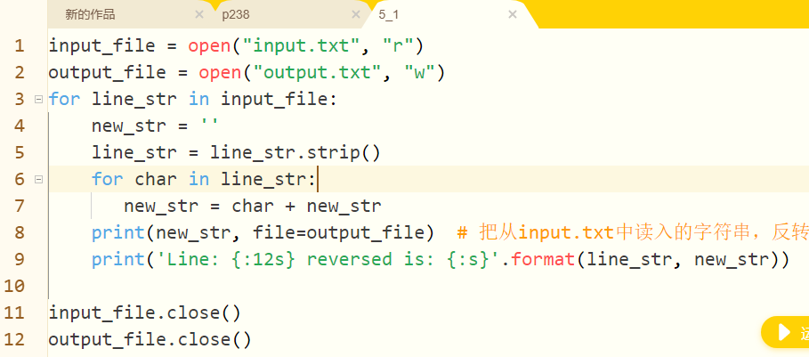
5_1.py

Slide 14
Reading a Text File/ Writing a Text File
练习：
写一个完整的程序，即能够从文件读入，又能把数据写入到文件中。
THINKING？
What will happen, if a file dose not exist?

Slide 15
5.5 File Creation and Overwriting
Problem？
What will happen， if you open a file which dose not exist?

Slide 16
When one opens a file for reading and the file doesn’t exist on the disk (or the operating system cannot find the file), an error is generated. If the file exists, the file object connection is created and we can read values from the file.
When one opens a file for writing and the file doesn’t exist, a file will be created in the folder where the program is running. If the file already exists, its contents will be cleared; that is, the file contents will be lost, and any new material is added to the now-empty file by default.

Slide 17
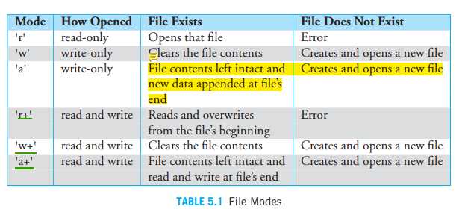
Different modes

Slide 18
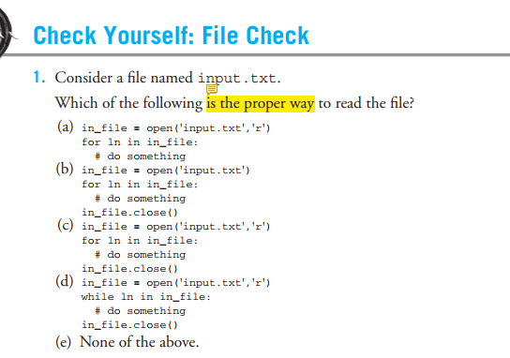

Slide 19
练习
将一个“西南大学.txt”中所有的“西南”，替换成“SWU”，保存在一个新文件“SWU.txt”中。
read_and_write_西南大学.py

Slide 20
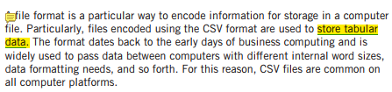
csv Files
*.csv —— A CSV is actually a text file.
http://www.jeffbigler.org/documents/Periodic-Table.xls

Slide 21
5.6 First Cut, Handling Errors

Slide 22
Two Types Error in Programs
Syntax Errors （语法错误）
Syntax errors are errors where the code we as programmers write is malformed. Somehow the code does not follow the rules of Python.
Runtime Errors (运行时错误）
Exception System

Slide 23
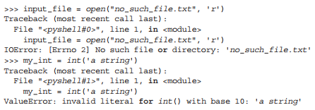
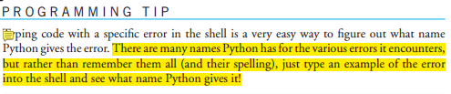
Error Names
Python provides very specific error names to the various situations that occur when something goes wrong.

Slide 24

The try-except Construct
How can a programmer know what to watch?
The try suite contains code that we, as programmers, want to “watch over” for possible runtime errors. That is, we are concerned about a suite of code that might cause a runtime error.
Each except clause has associated with it a particular Python error name, and a suite of code that will run, if that particular error occurs.

Slide 25

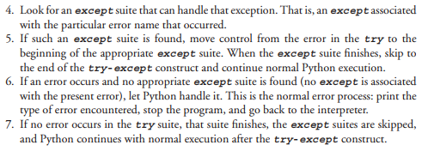
try-except Flow of Control

Slide 26
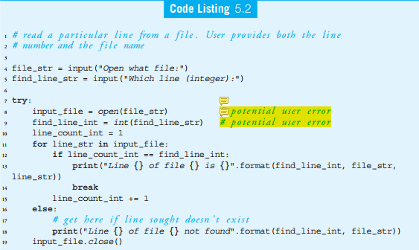

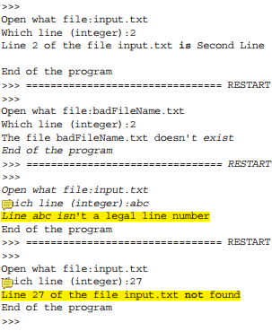
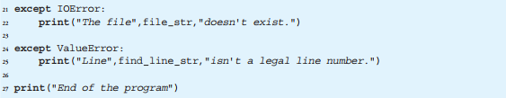
Example
The goal of the program is: to read a particular line, indicated by a line number, from a file. The user is required to provide both the file name and the line number.

Slide 27
THINKING？
It seems wasteful to enter a line number, if the file cannot be opened. How can we fix that?
An adjustment to this code would be to keep asking for input until it is correct. That is, keep asking for a file until it can be opened.

Slide 28
